Slide 1

Unocal Corporation
IST 625 ERM Case Study, Summer 2019
Nicholas Abrahamson , Adil Gokturk, Nick Rossmann, Lane Tunstall

Slide 2
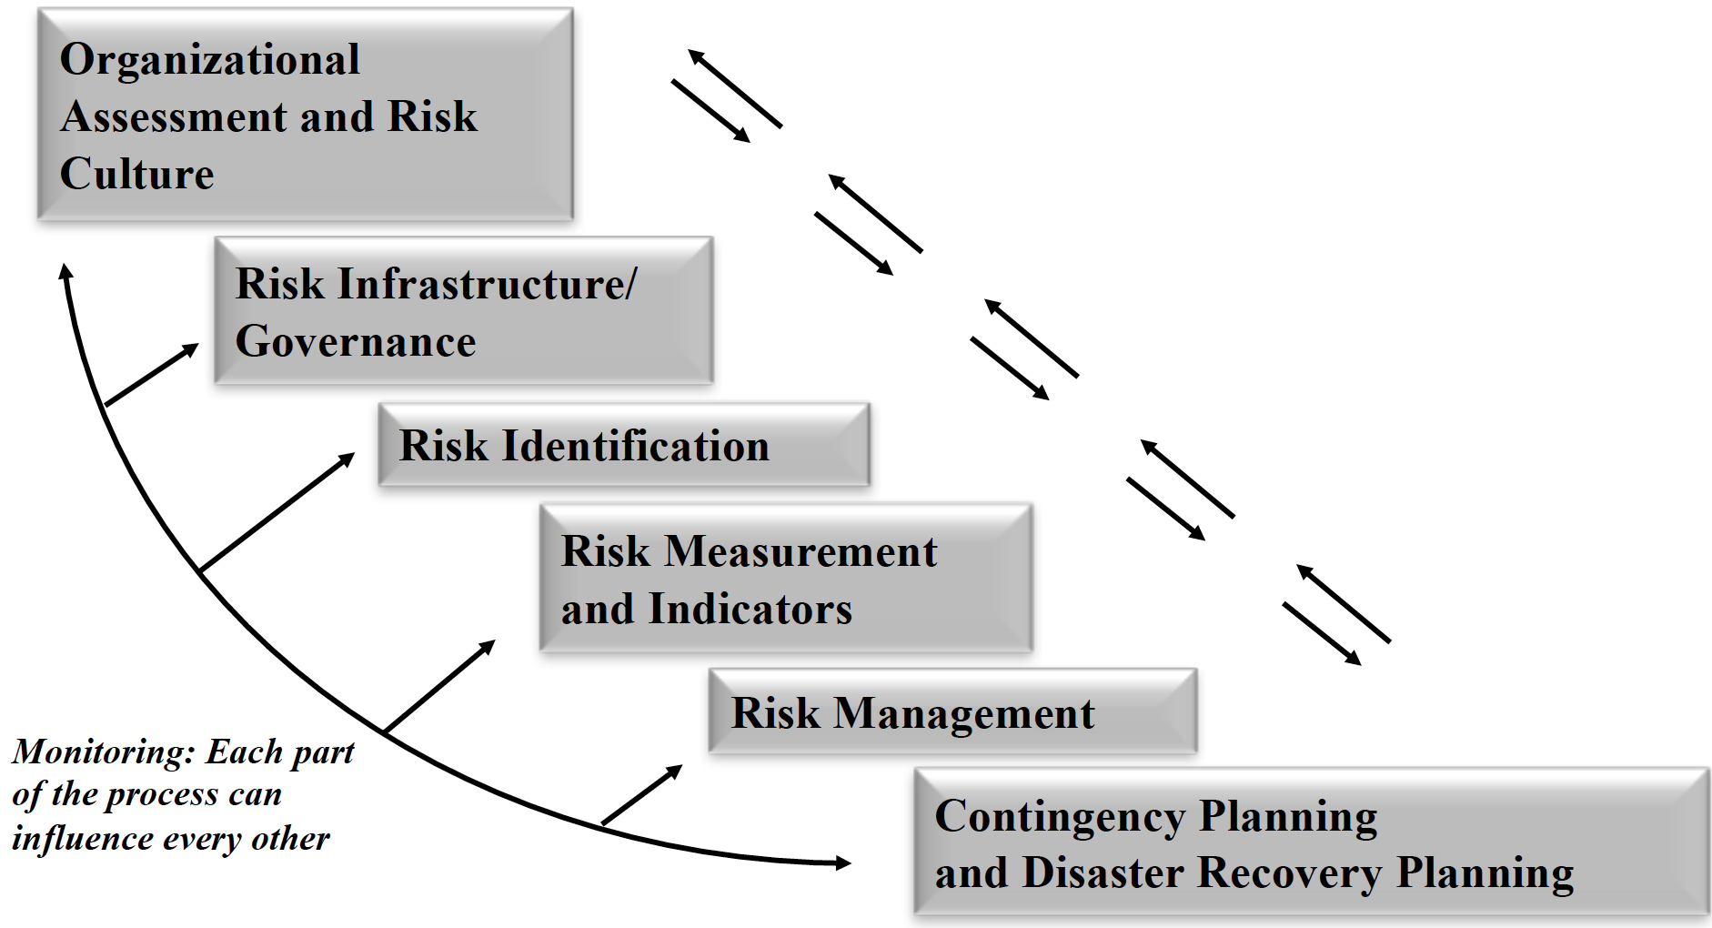
Enterprise risk Management
erm process

Slide 3

Organizational Assessment & Risk Culture - History
The Enterprise Risk Management —ERM Process
Union Oil Co
Lyman Stewart formed company and moved to California in the 1880s
Key elements of founding culture
“Independent” – had staved off takeover attempts from Royal Dutch Shell (1922) and T. Boone Pickens (1985)
Low cost driller
Pioneer in exploration
History of “incidents” (California Lightning strikes)

Slide 4
Organizational Assessment & Risk Culture
The Enterprise Risk Management —ERM Process
Where did it take them?
Sell off Union 76 name/retail in 1997
Drill deeper in Gulf of New Mexico (deep water)
Drill in unstable parts of the world
Later sold in 2005 to Chevron for nearly $18b
Key Elements of Oil Business: Oil Reserves are Value; Reserves can be depleted quickly and need to be replenished

Slide 5
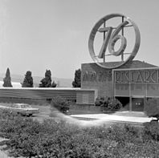
Risk infrastructure & Governance - risk factors
The Enterprise Risk Management —ERM Process
Financial
Sociopolitical
Construction
Operating
Revenue
Appraisal

Slide 6
Risk identification - Risk Shift
Text
Old Risk
Compliance driven, 800 questions, “Health, Environment, Safety” (HES) Audits
One size fits none type policy
New Risk
Devolve authority: Everyone is a risk manager
Risk Profiles to assess geopolitical/economic risks in drilling in new regions
Monte Carlo analysis for forecasting drilling locations with geological data
Internal audit to drive business value

Slide 7
Risk identification- Change Agents
The Enterprise Risk Management —ERM Process
Karl Primm, Internal Audit - from one of the Big 5 Accounting firms
“When I came here, we had something like 1,500 audit units”
George Walker, Health, Environment and Safety
Tim Ling, CFO – from McKinsey
“Risk management should be a line function, not a staff function, and a good manager is a good risk manager. “ (182)

Slide 8
Risk Measurements and indicators
The Enterprise Risk Management —ERM Process

Slide 9
Risk Management
The Enterprise Risk Management —ERM Process

Slide 10
Contingency planning & disaster Recovery planning
The Enterprise Risk Management —ERM Process
Disaster planning is informed by ‘incidents’ or actual accidents and disasters the company and its peers experienced.
In 1926 Unocal lost 8million barrels of oil, or 1/8th of its 1999 production total, due to lightning caused fires at company tank storage facilities.
Like other high tech industries, contingency planning for Unocal requires a multi-pronged approach. Unocal must develop risk measures to address production disparities and against highly visible ‘incidents’, but also like other commodity-based businesses, price and market fluctuations can be as equally detrimental to margins. For example, ‘a $1 change in worldwide oil prices per barrel, would lead to a $33 million change in net income.

Slide 11
Contingency planning & disaster Recovery planning
The Enterprise Risk Management —ERM Process
Unocal staked its future on deep sea drilling, between 5,000-10,000 ft. Underwater drilling at these depths provide many more challenges and factors vs. drilling in the 3,000-4,000 depths. Risk is primarily financial in that it is expensive to hire specialty contractors with significant overhead. Because deepwater drilling is such a financial risk, very close attention need be given to the volatile price of oil.
Health, environmental, and safety concerns are huge issues for Unocal, like other oil and gas exploration and production organizations. To that end, Unocal implemented a system known as International Safety Rating System to audit Unocal’s safety procedures and compliance. No longer is Unocal reactive to HES risks, but rather relevant, up to date best practices and procedures are part of every day operations.

Slide 12
Contingency planning & disaster Recovery planning
The Enterprise Risk Management —ERM Process
Ling describes a challenge of getting the ‘line guys’ and field foremen to be as cognizant about safety as staff specifically tasked with safety oversight. HES risk required buy-in from all organizational levels.
ISRS was eventually phased out as operators were frustrated with its 800 check marks on different compliance areas. Unocal moved to a more intuitive system whereby managers, through self-assessment, would identify areas of the greatest risk concern and develop steps to manage those areas.

Slide 13
Contingency planning & disaster Recovery planning
The Enterprise Risk Management —ERM Process
A culture change occurred when ISRS was phased out and now Unocal simply asked managers to assess risks in their areas and determine different programs would fit each unique risk. Line managers were resistant as the new system was perceived as onerous. The shifts in responsibilities from safety staff to managers and line workers in the plants presented a culture change challenge.
Geo-political pressures put further constraints on contingency planning for Unocal. For the Unocal Geothermal Indonesia, a risk matrix of field operations was created to identify probability: impact risks.

Slide 14
Conclusion
The Enterprise Risk Management —ERM Process
Risk management at Unocal required a top down risk culture change.
No longer were risks looked at one by one, piecemeal, as with the compliance framework, but rather risk should be assessed by line workers, foremen, and operations managers on the ground, so to speak.
Unocal’s risk factors are numerous and complex and include: financial, sociopolitical, construction, operating, revenue, and appraisal elements.
A focus on Health, Environmental, and Safety risks resulted in several audit processes and tinkering with different risk control structures.

Slide 15
references
The Enterprise Risk Management —ERM Process
Barton, T. L., Shenkir, W. G., Walker, P. L., & Financial Executives Research Foundation. (2001). Making enterprise risk management pay off. Morristown, N.J.: Financial Executives Research Foundation.
Chapman, R. J. (2006). Simple tools and techniques of enterprise risk management. Chichester, West Sussex, England ; Hoboken, NJ: J. Wiley & Sons.

